Slide 1
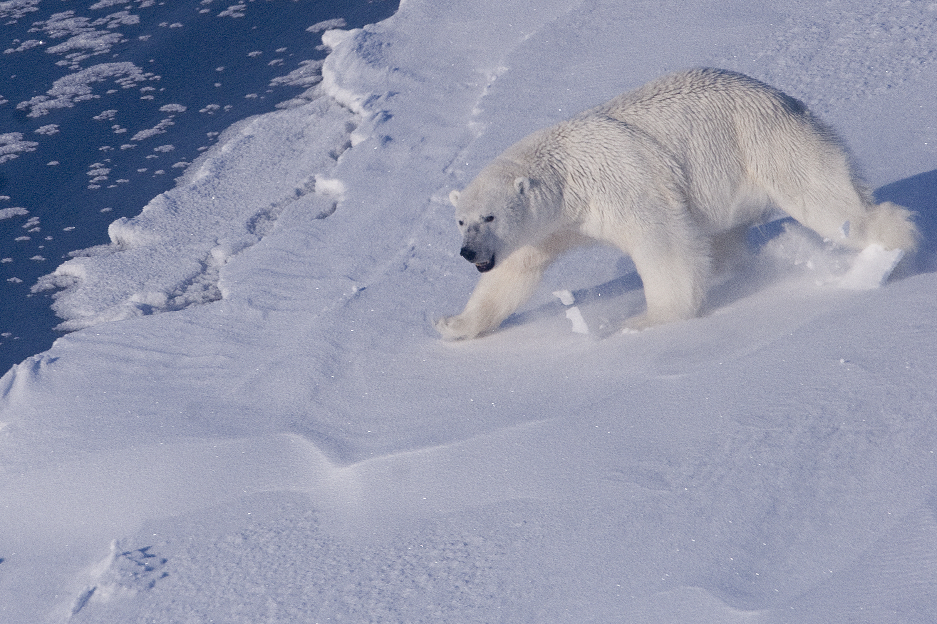





Climate change, sea ice, and polar bears in Greenland
Kristin L. Laidre, Harry Stern, Erik W. Born, Øystein Wiig
Greenland Institute
of Natural
Resources
F Ugarte

Slide 2
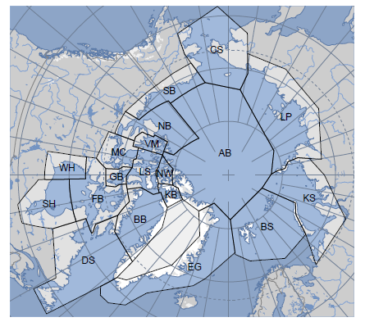
19 sub-populations of polar bears worldwide
3 in West Greenland (based on satellite telemetry + genetic studies)
Kane Basin
Baffin Bay
Davis Strait
1 in East Greenland
IUCN Polar Bear Specialist Group (2009)
Notes:
Pop size of KB and BB unknown, 2200 bears in 2007 in DS

Slide 3
Objectives
Evaluate change in polar bear sea ice habitat in the Arctic
Quantify and predict sea ice loss impacts for sub-populations of polar bears in Greenland
Notes:
Pop size of KB and BB unknown, 2200 bears in 2007 in DS

Slide 4
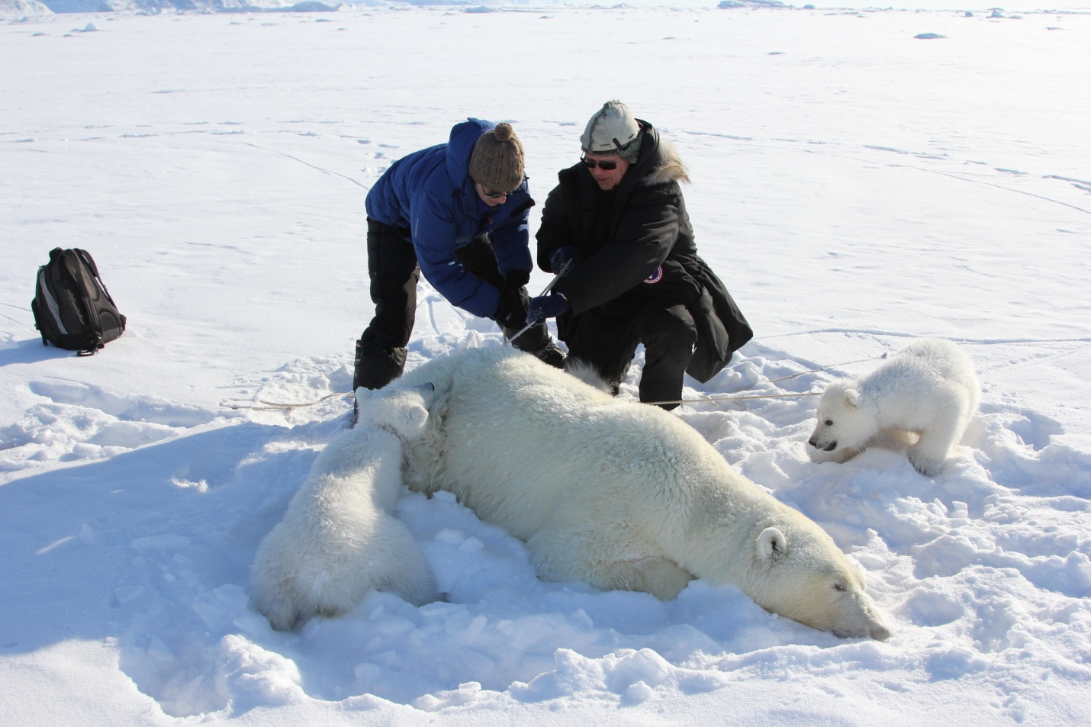
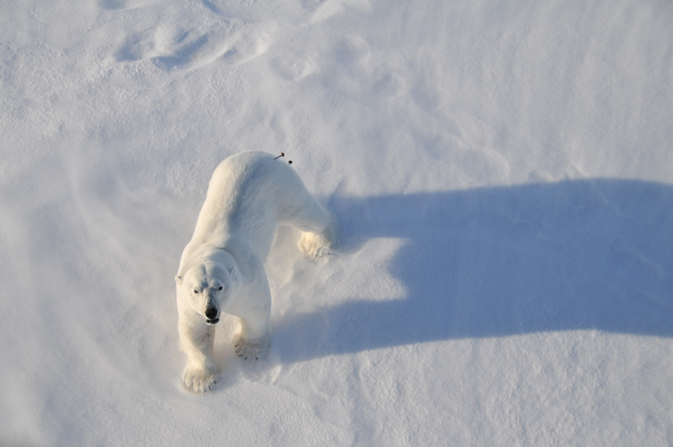
Work based on long-term time series of polar bear captures in Greenland (1993-2013)

Slide 5
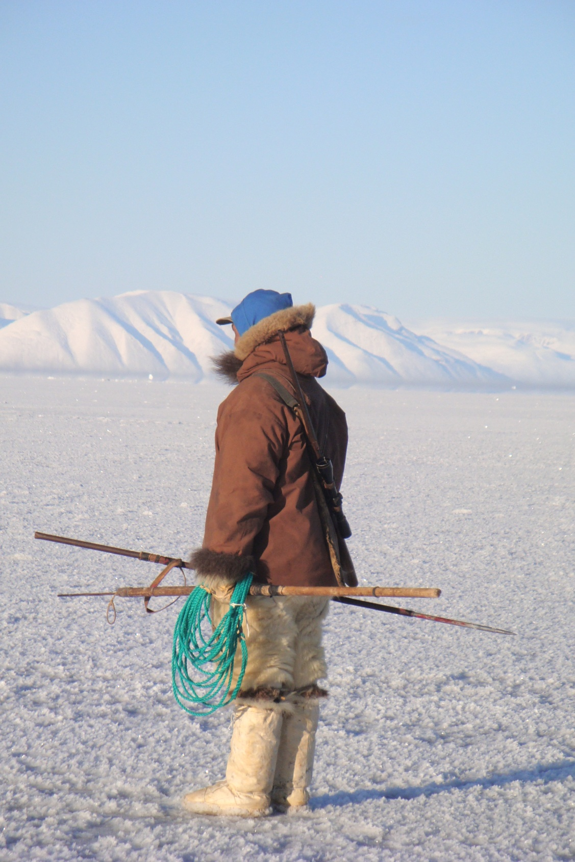
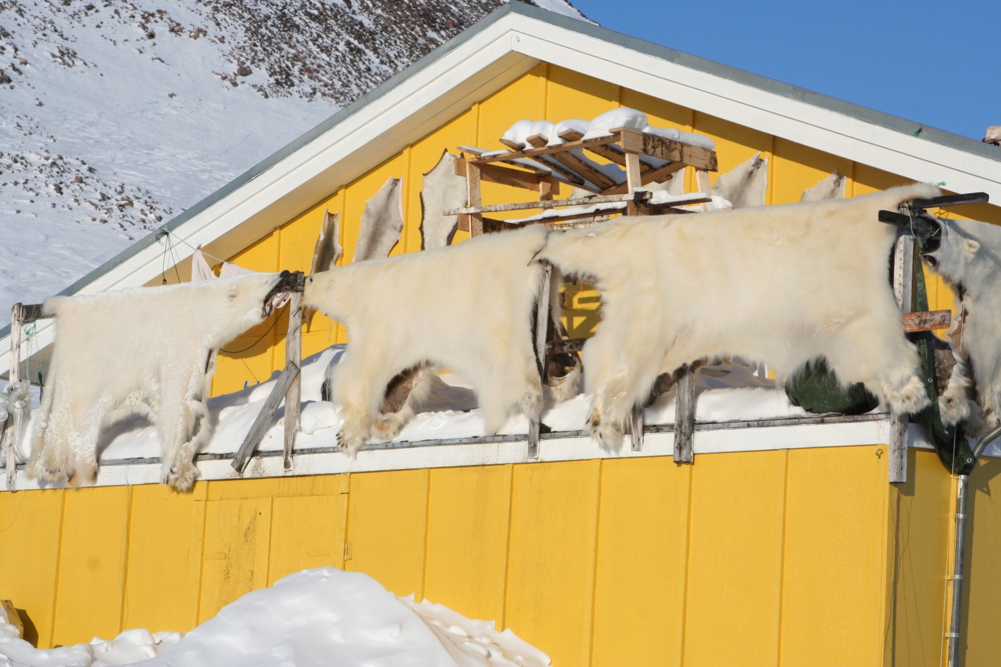
Relevant to 1) conservation of polar bears and 2) management of marine resources in a changing ecosystem
K L Laidre

Slide 6
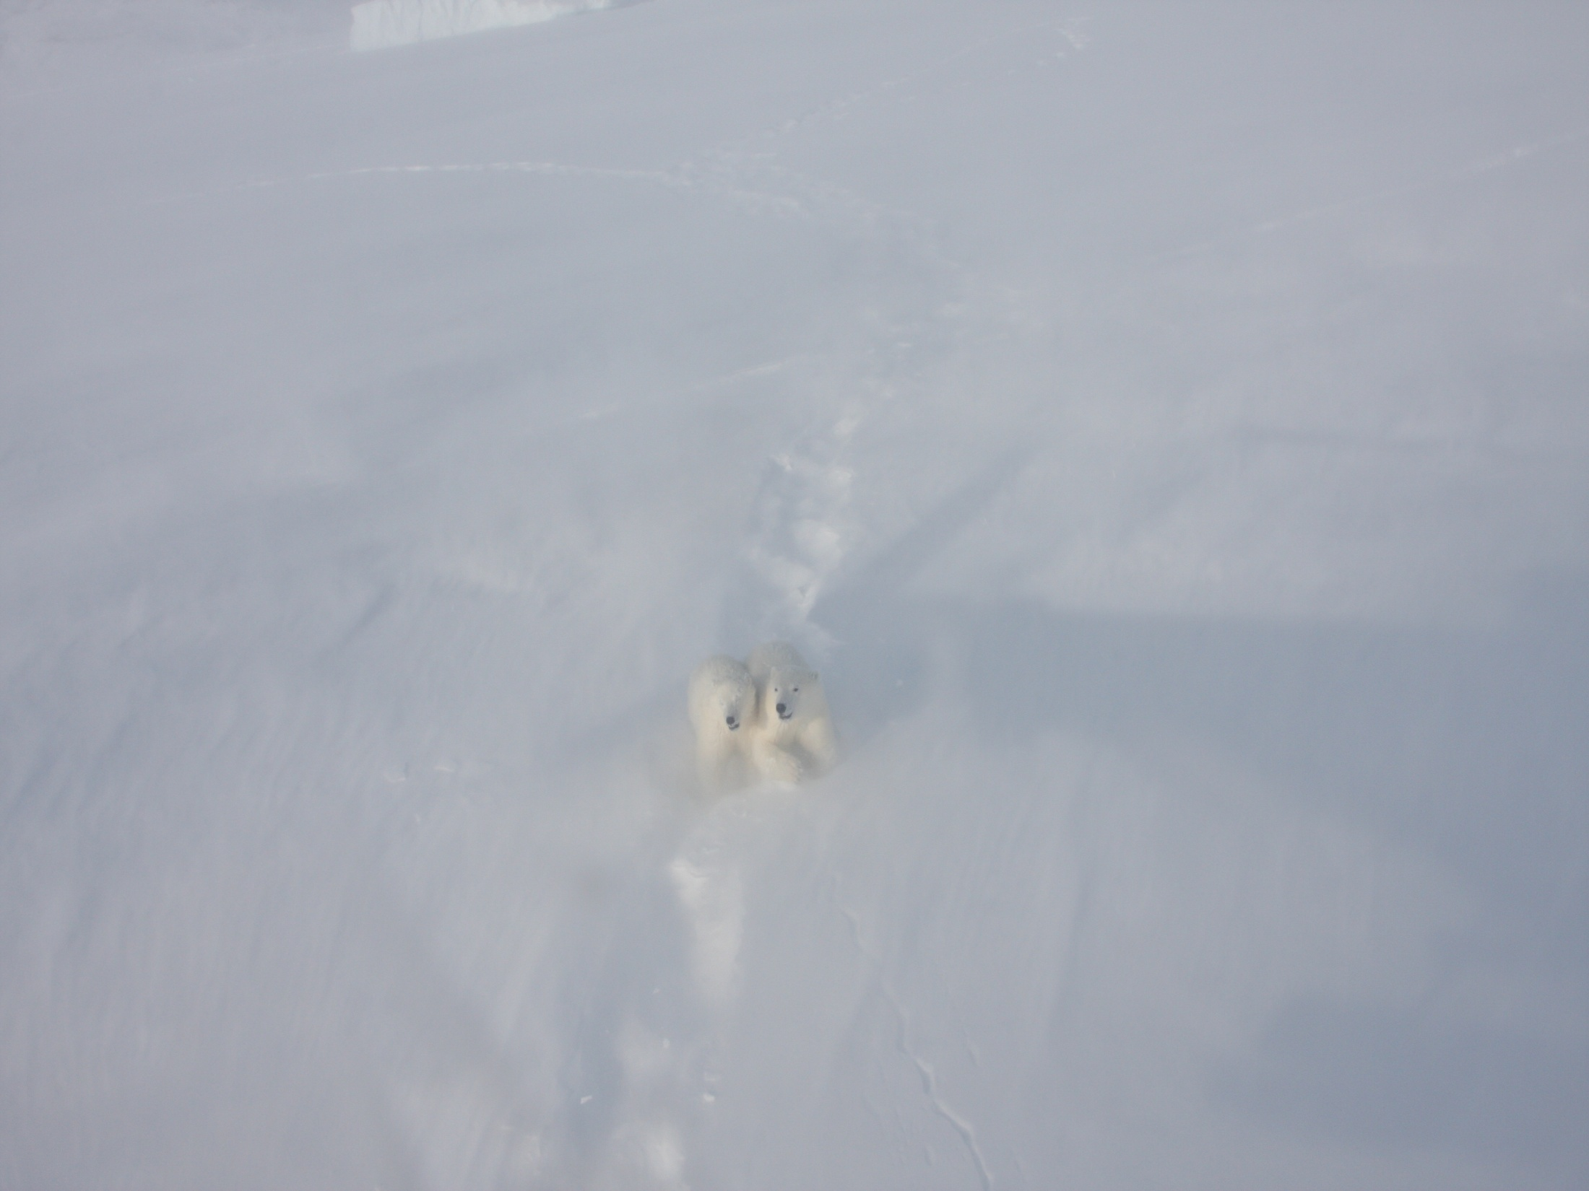
Three parts:
1. Contrast male and female movement during the breeding season
2. Resource selection using historical and present satellite telemetry data
3. Circumpolar sub-population specific trends in sea ice habitat change
Photo: K. Laidre

Slide 7
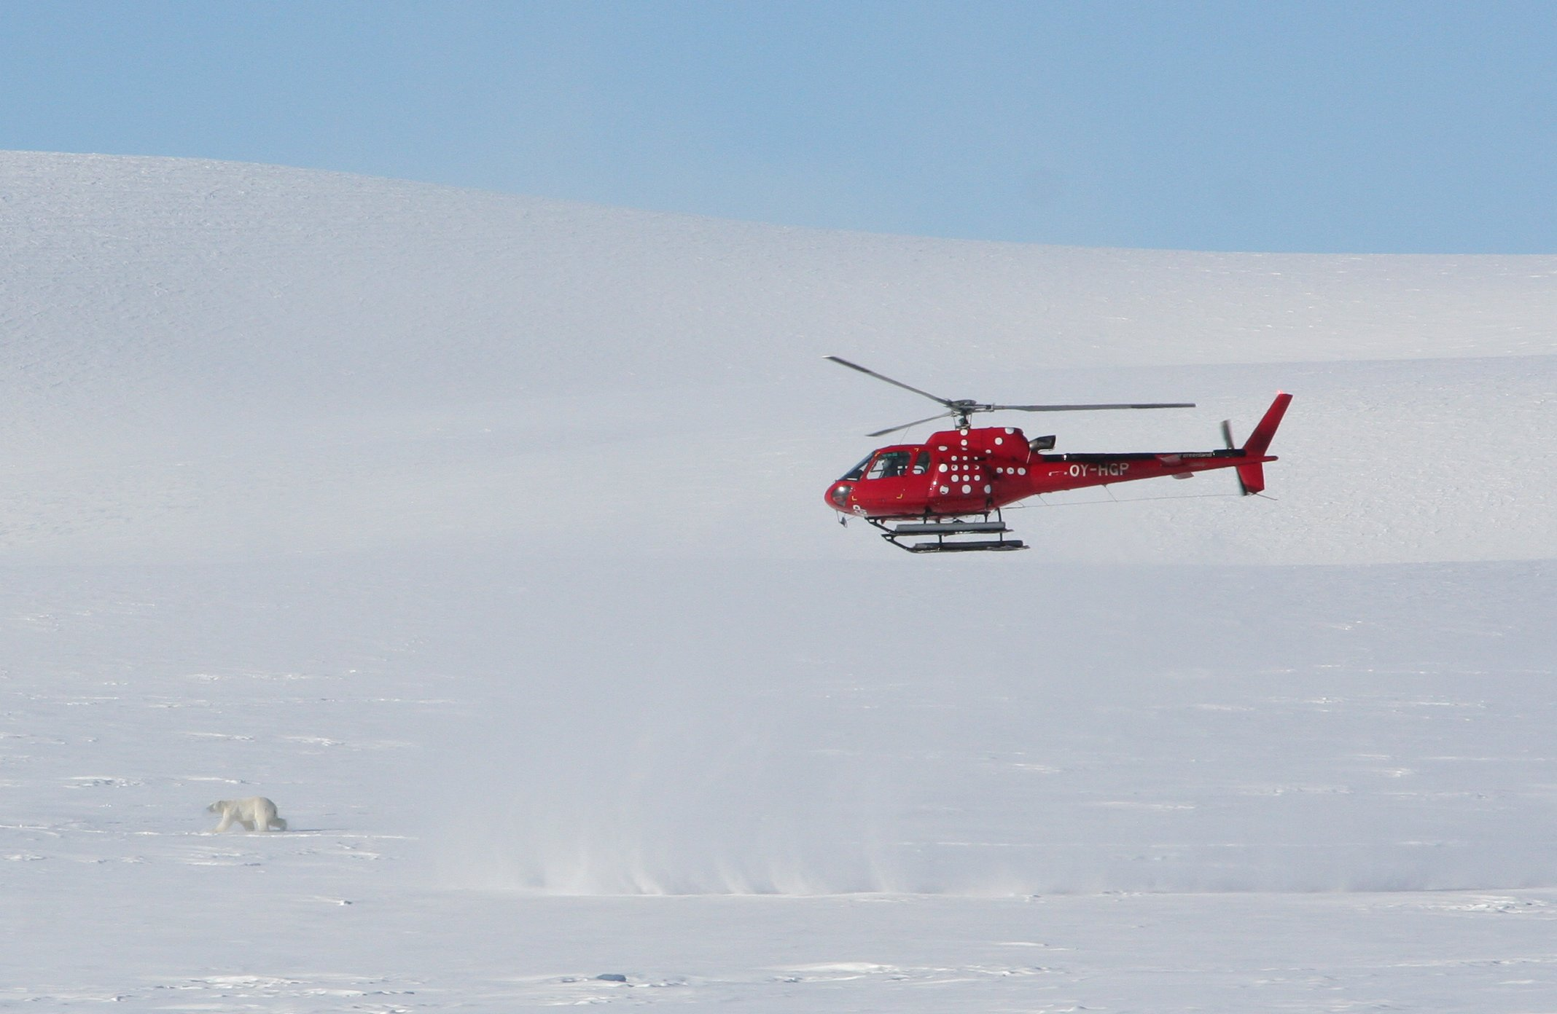
Brief field methods: Polar bear capture and marking efforts
K L Laidre

Slide 8
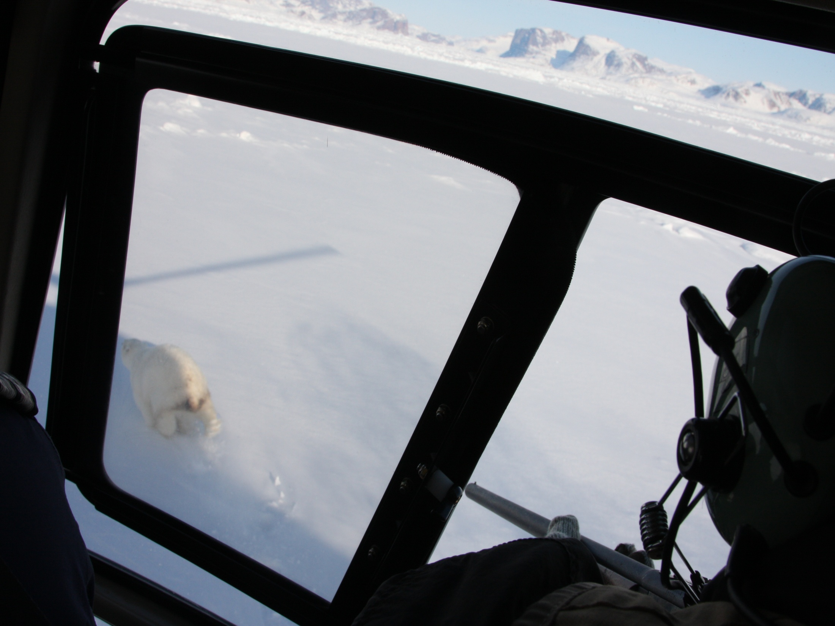
Photo: K. Laidre

Slide 9
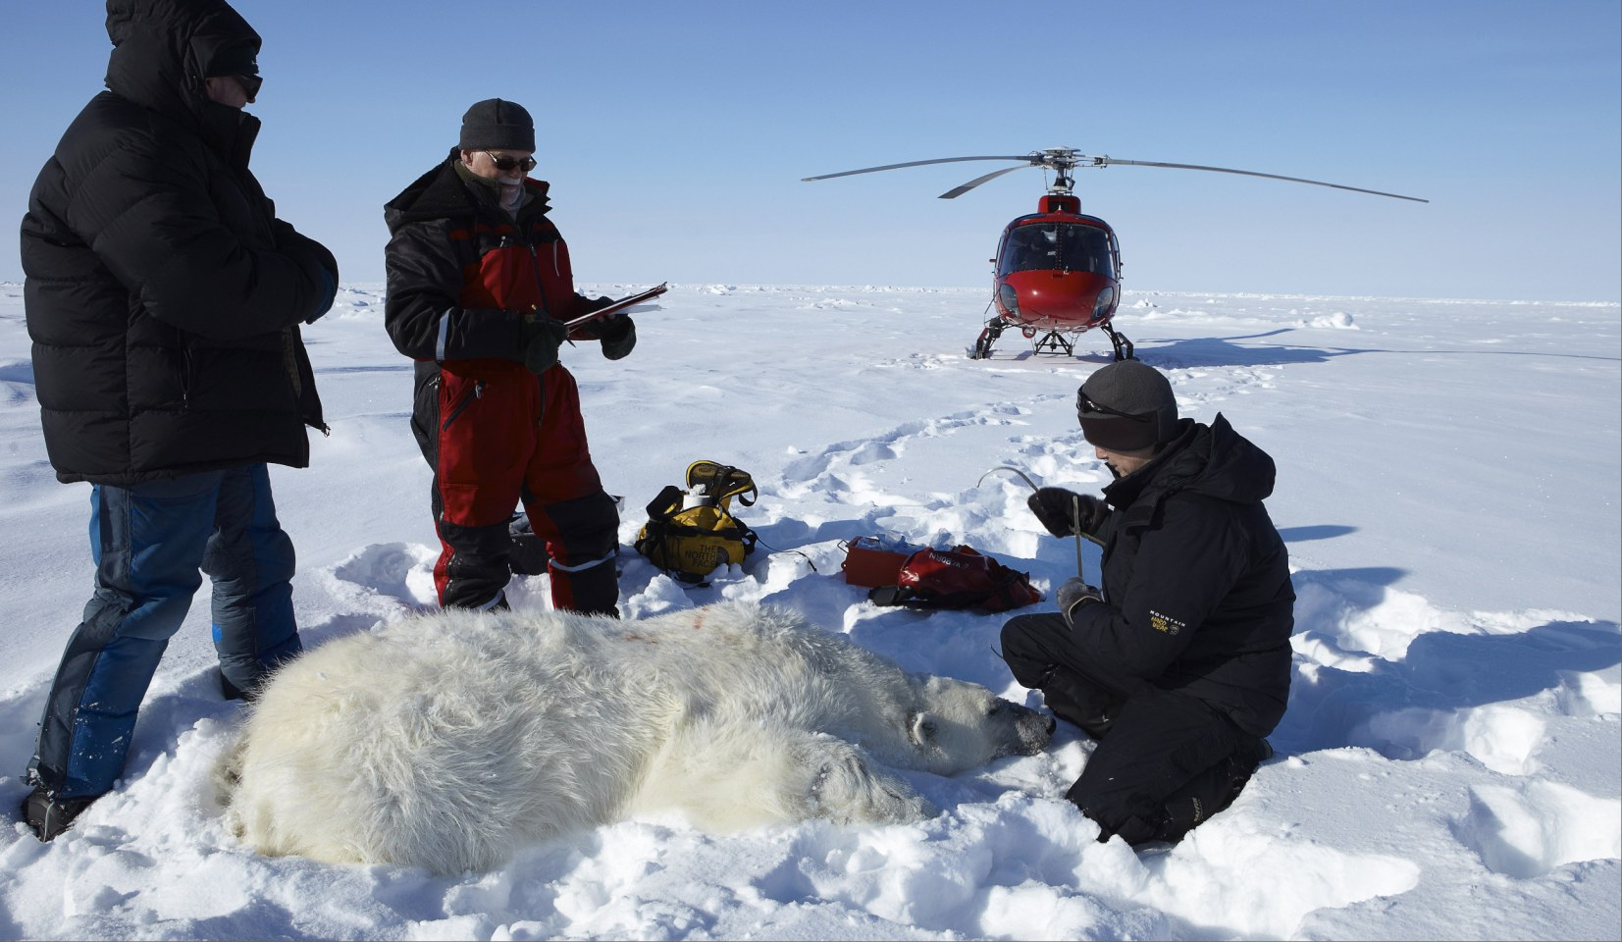

Slide 10
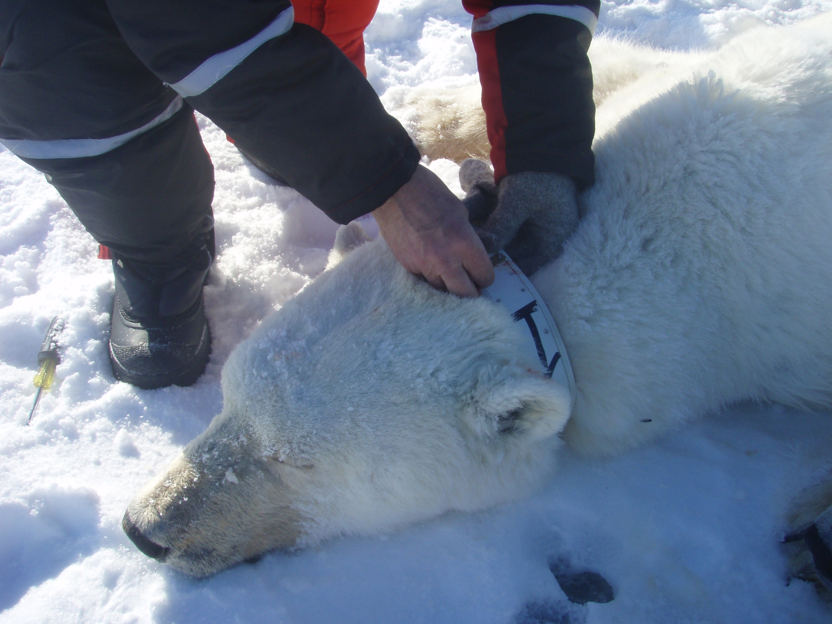
Females
K L Laidre

Slide 11
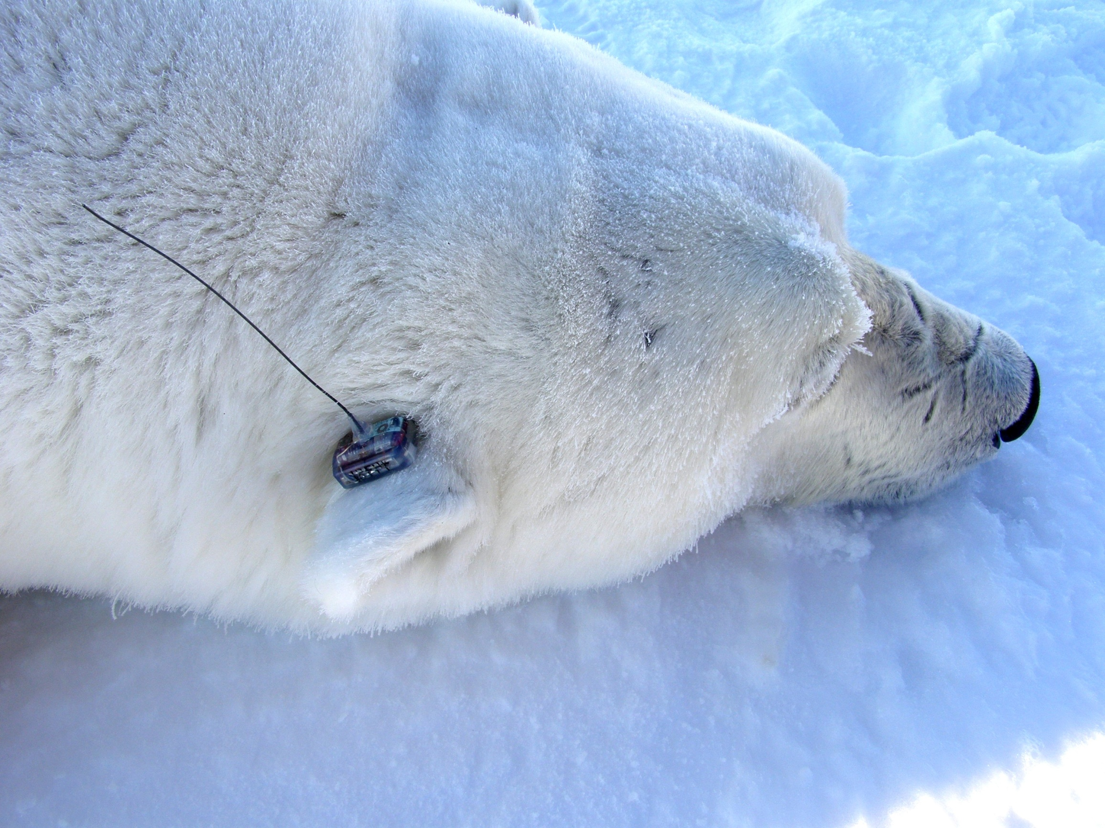
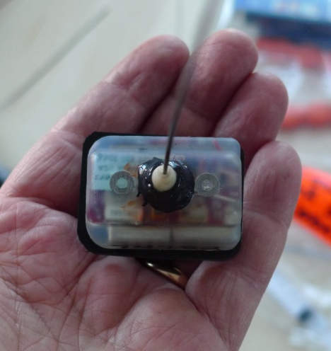
Males only
10 cm
K L Laidre

Slide 12
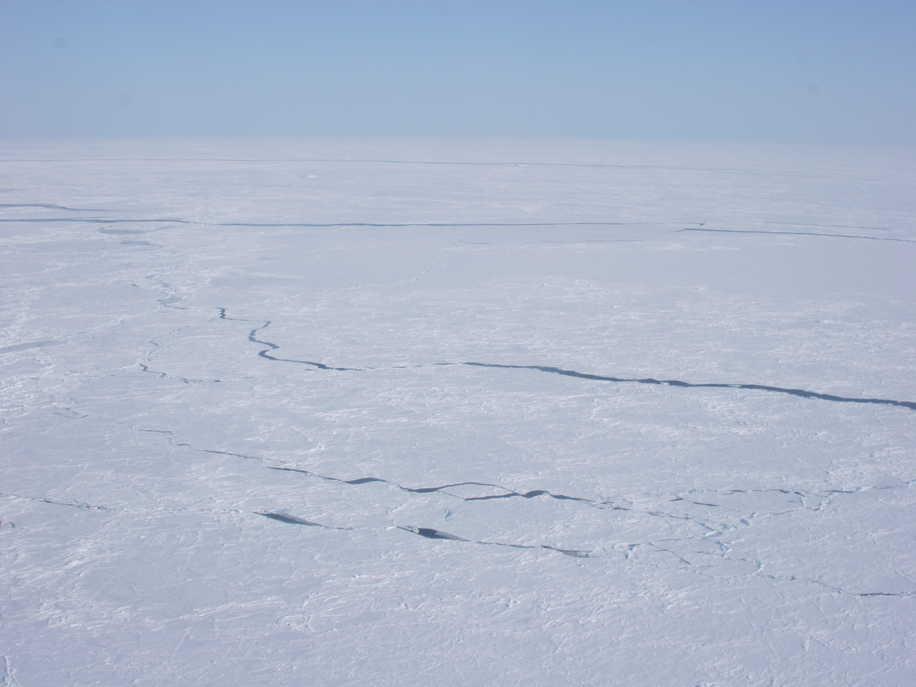
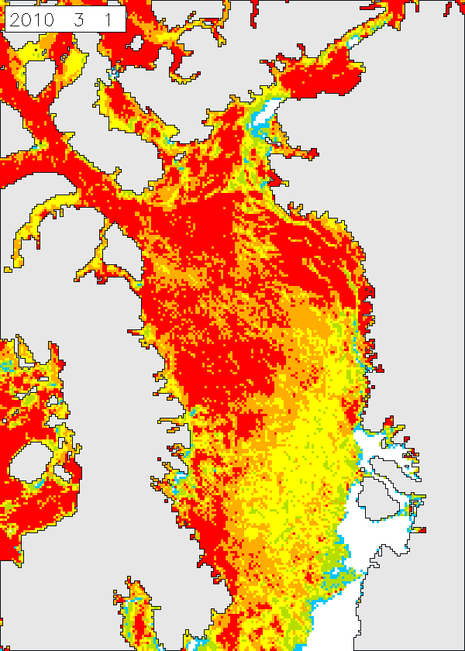

What is ‘Pack ice’?
Sea ice unattached to land
Dynamic
Moves >20 km/day in West Greenland, >70km/day in East Greenland
9-10% decrease/decade
Greenland
Canada
AMSR-E

Slide 13
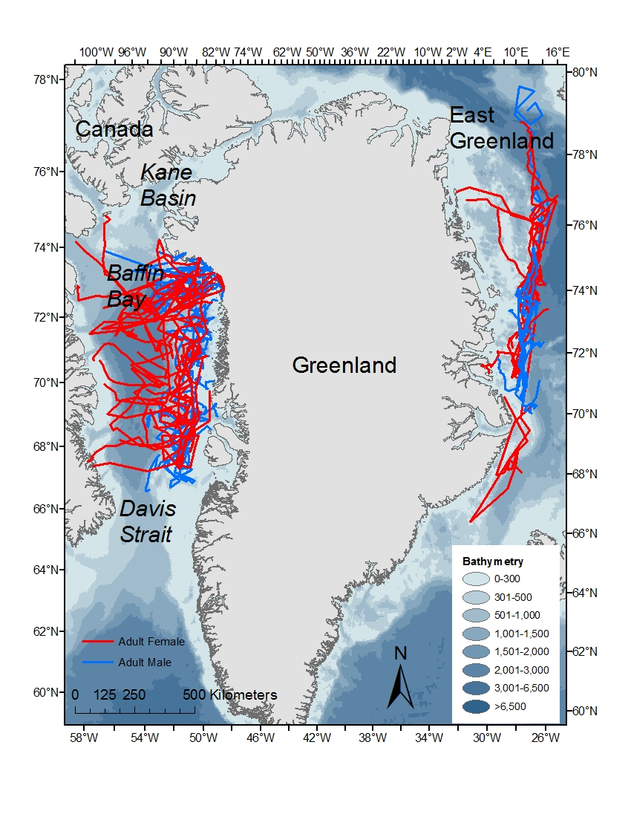
1. Male and female movement
Compare of adult males and adult females (n=23/26)
Baffin Bay and East Greenland during the mating period
April-May pack ice
Data from 2007-2011

Slide 14
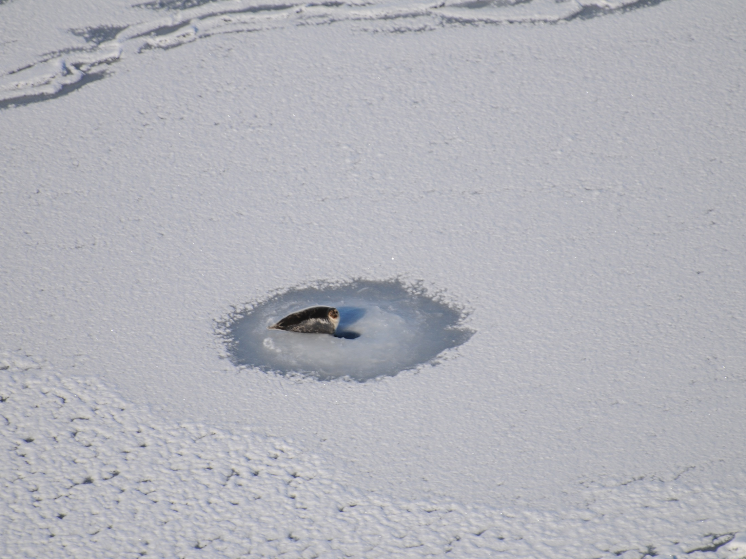
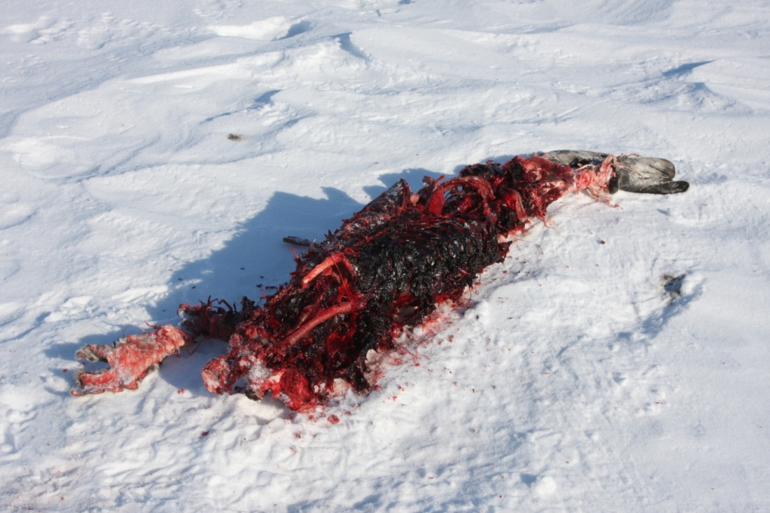
Primary prey for polar bears is the ringed seal
In spring, ringed seals occupy lairs or sit at breathing holes
Sea ice is a critical platform for feeding
Photo: O. Wiig

Slide 15
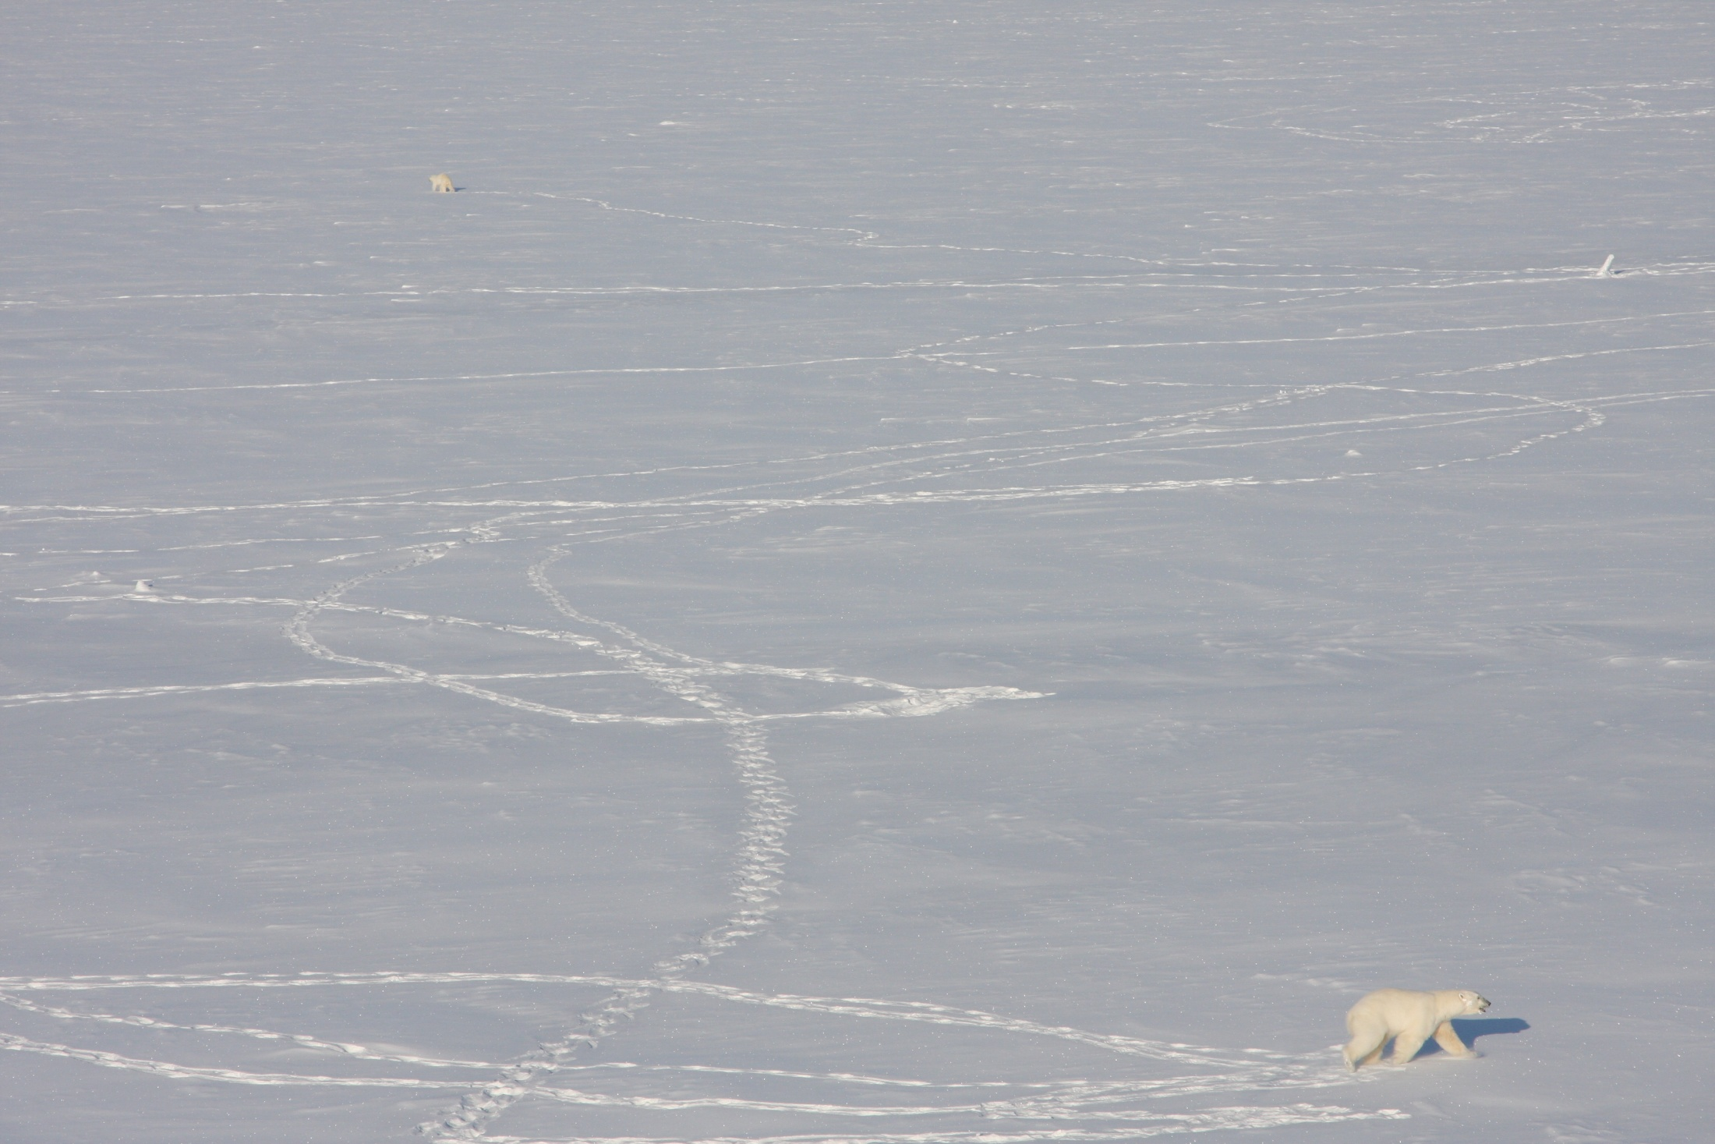
Spring is also a critical period for breeding pair formation and mating
K L Laidre

Slide 16
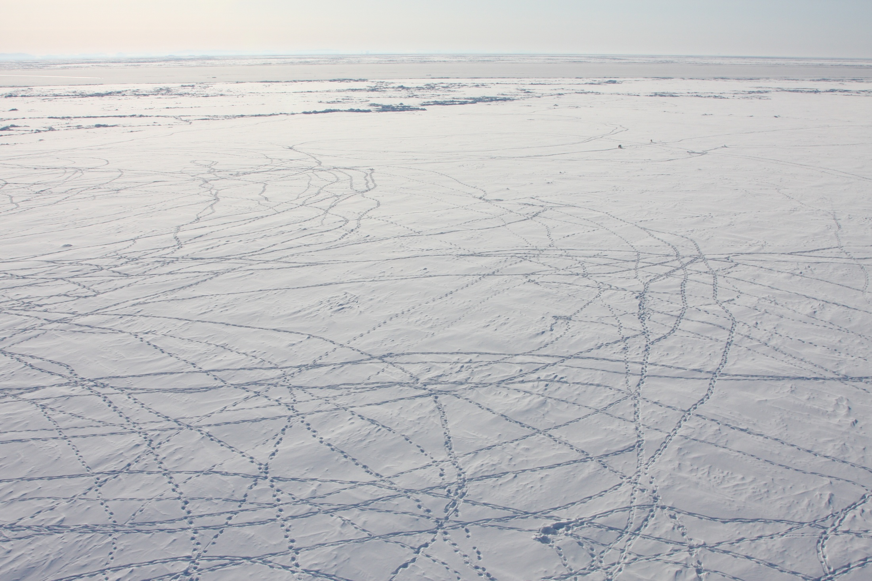
We compared:
Four-day and hourly velocities (displacement)
2) Linearity of movements (persistence index - mean cosine of the turning angles between consecutive steps)
3) Kernel breeding range sizes
4) Sex-specific sea ice habitat selection (SSMI and AMSR-E)
Notes:
The combination of displacements and persistence index are the basic components of correlated random walk (CRW) models

Slide 17
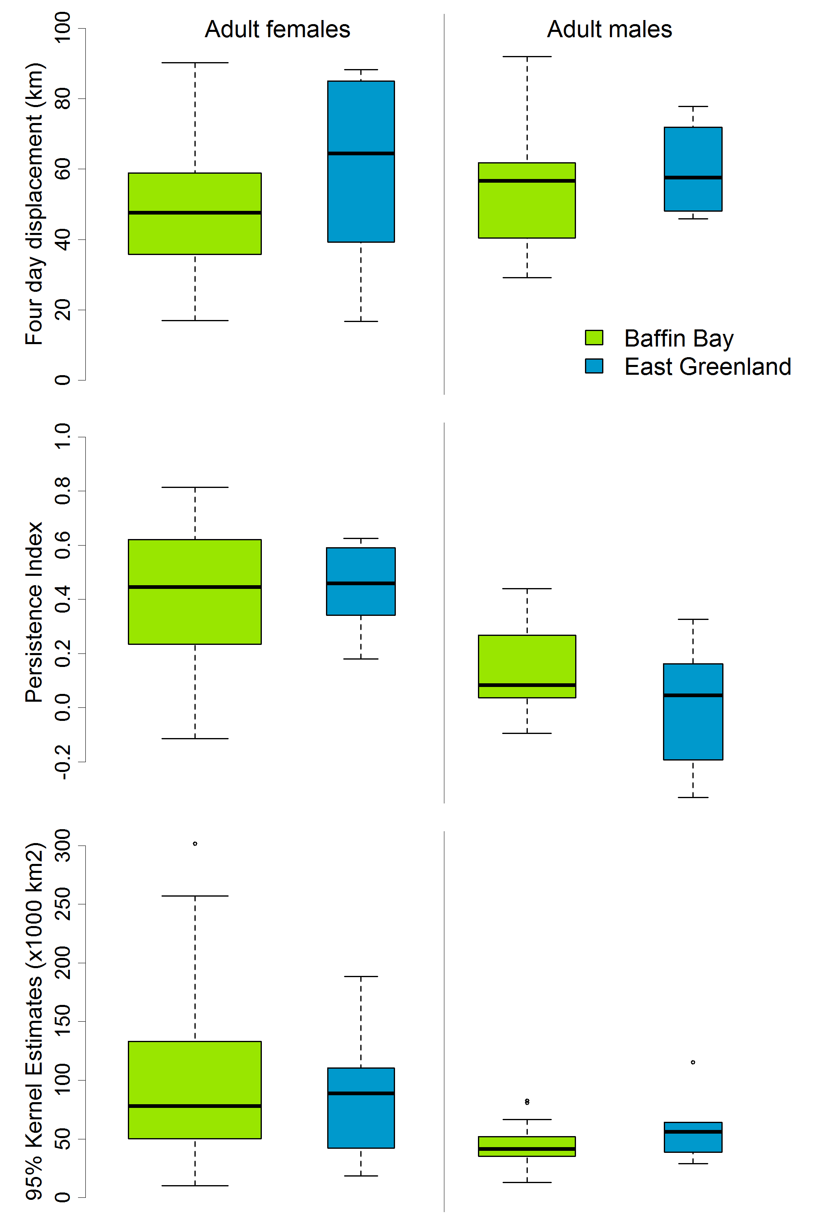
Median value, 25% and 75% interquartile range for:
(a) 4-day displacement values in km,
(b) Linearity of movement (persistence index)
(c) 95% kernel home range (km²)
NOT SIGNIFICANT
P<0.001
P<0.001
Notes:
The mean four day displacement for all bears was 50.0 km (sd 20.7), with no significant differences between sex or population.
Mean persistence index value (linearity of movement) for adult females (mean 0.43, sd 0.23) was significantly higher (more directed) than adult males (mean 0.01, sd 0.19, p<0.001) in all years and in both populations.
The 95% kernel home ranges for adult females significantly larger than those for adult males in both populations (p=0.001).

Slide 18
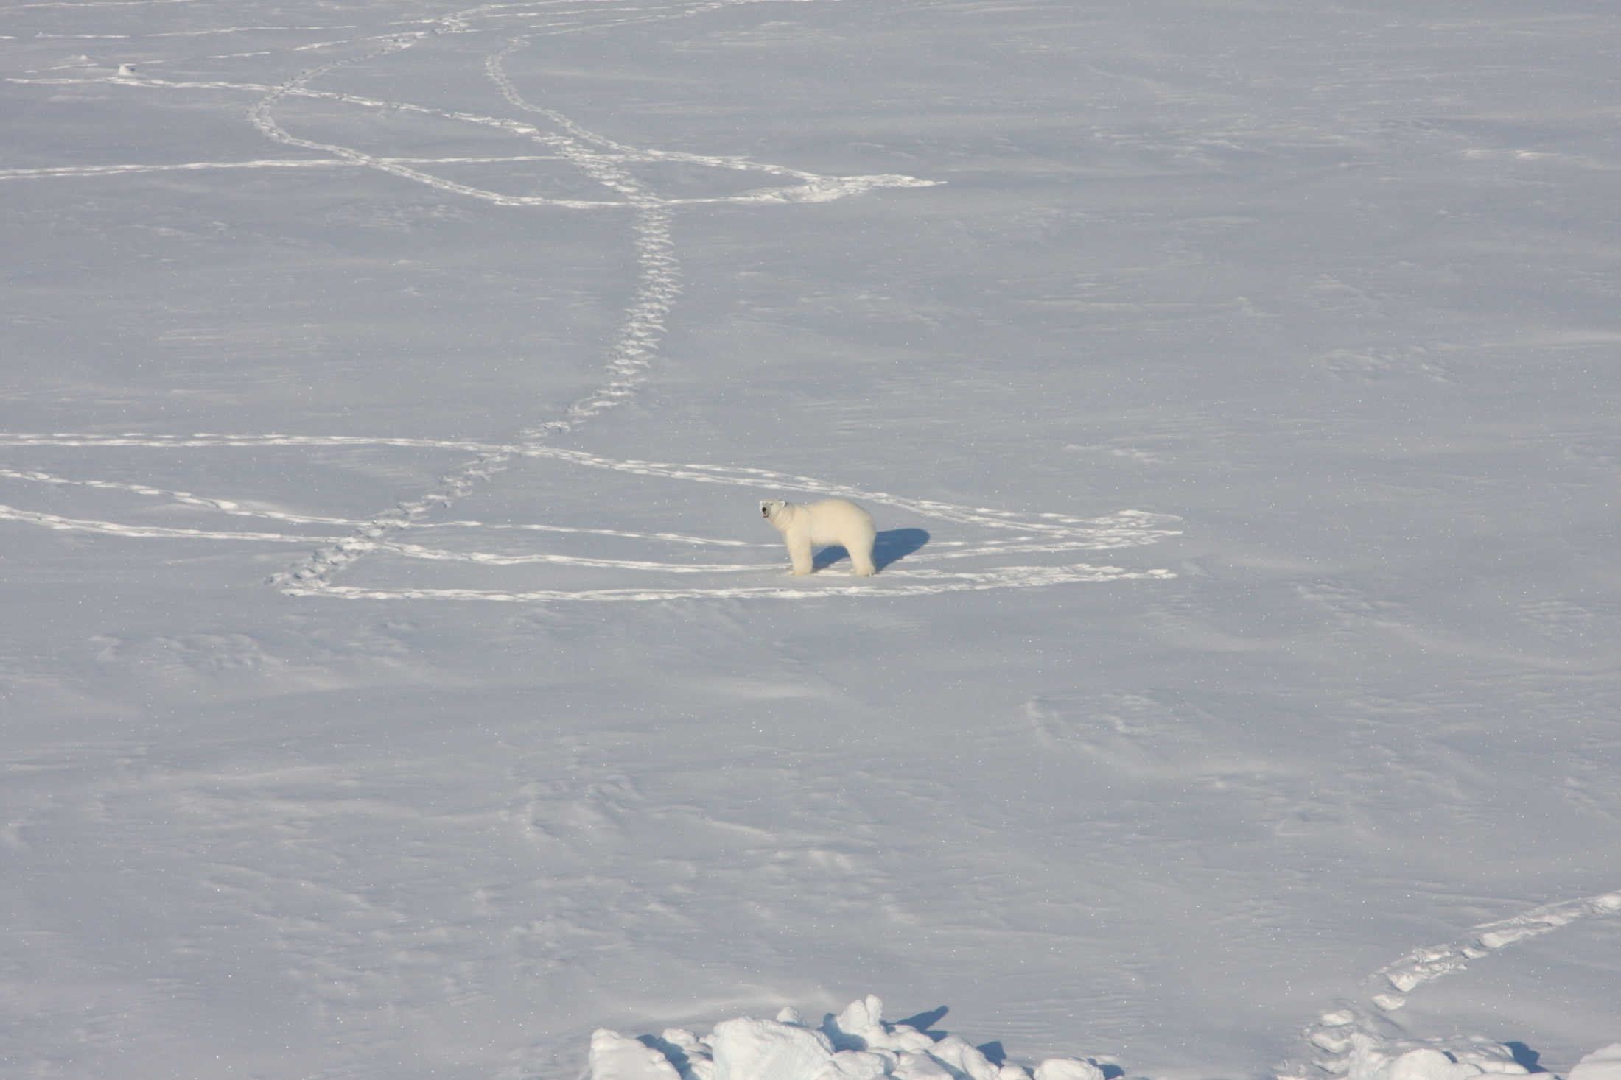
Adult females moved in significantly more linear paths and had significantly larger breeding ranges than adult males.
Significant in all years and for both populations.
K Laidre

Slide 19
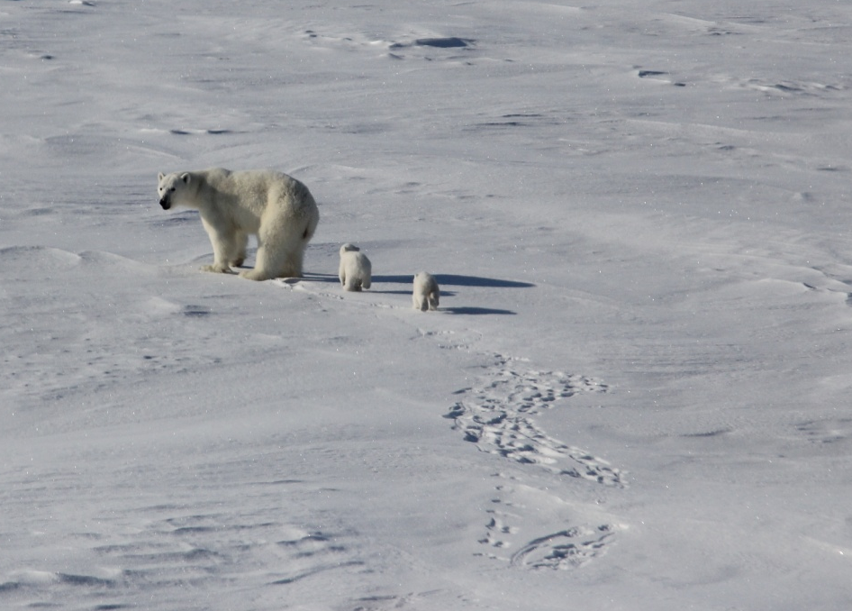
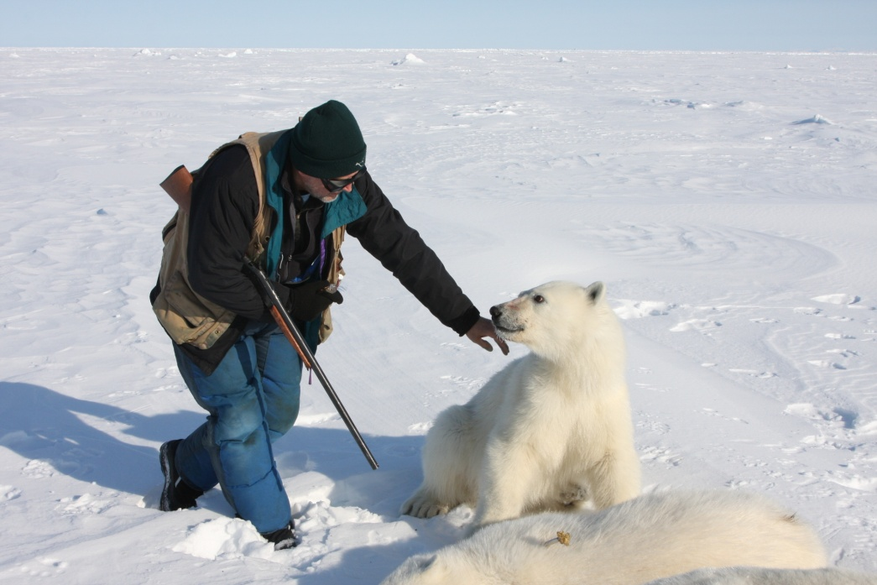
Results independent of female reproductive availability
Year was not a significant covariate in explaining variation in linearity of movement.
Result of sex-specific habitat selection?
Cubs of Year
Yearling

Slide 20
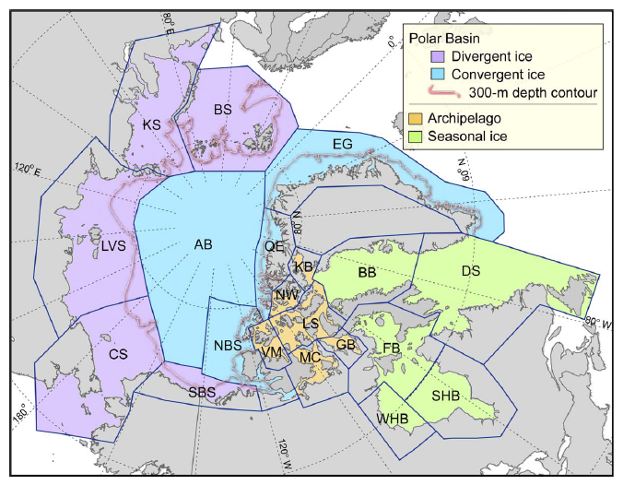
Explained by difference in sea ice regimes?
Durner et al. 2009
Notes:
Seasonal regions represent 60% of polar bears worldwide

Slide 21
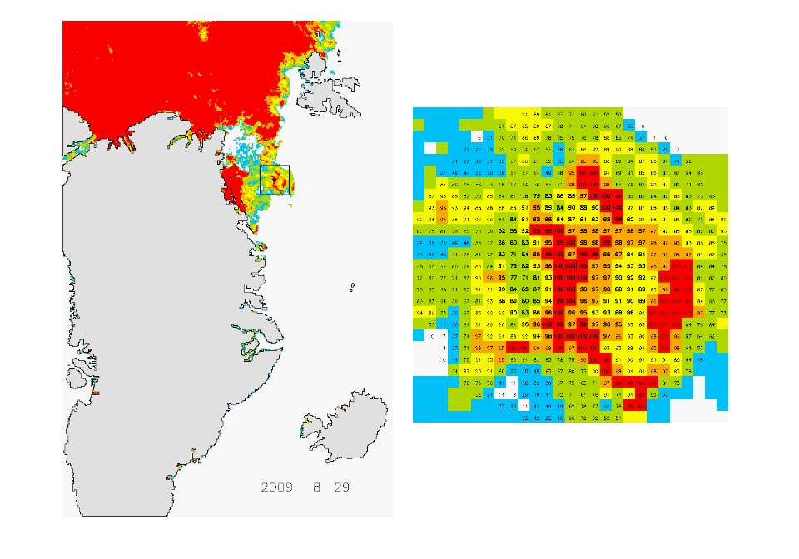
Sea ice: AMSR-E instrument on NASA Aqua satellite
Linear mixed effects models of bear presence as a function of:
sea ice concentration (%) at 3 scales (at bear and two buffers)
distance to sea ice edge (15% and 50% sea ice)
distance to shore

Slide 22
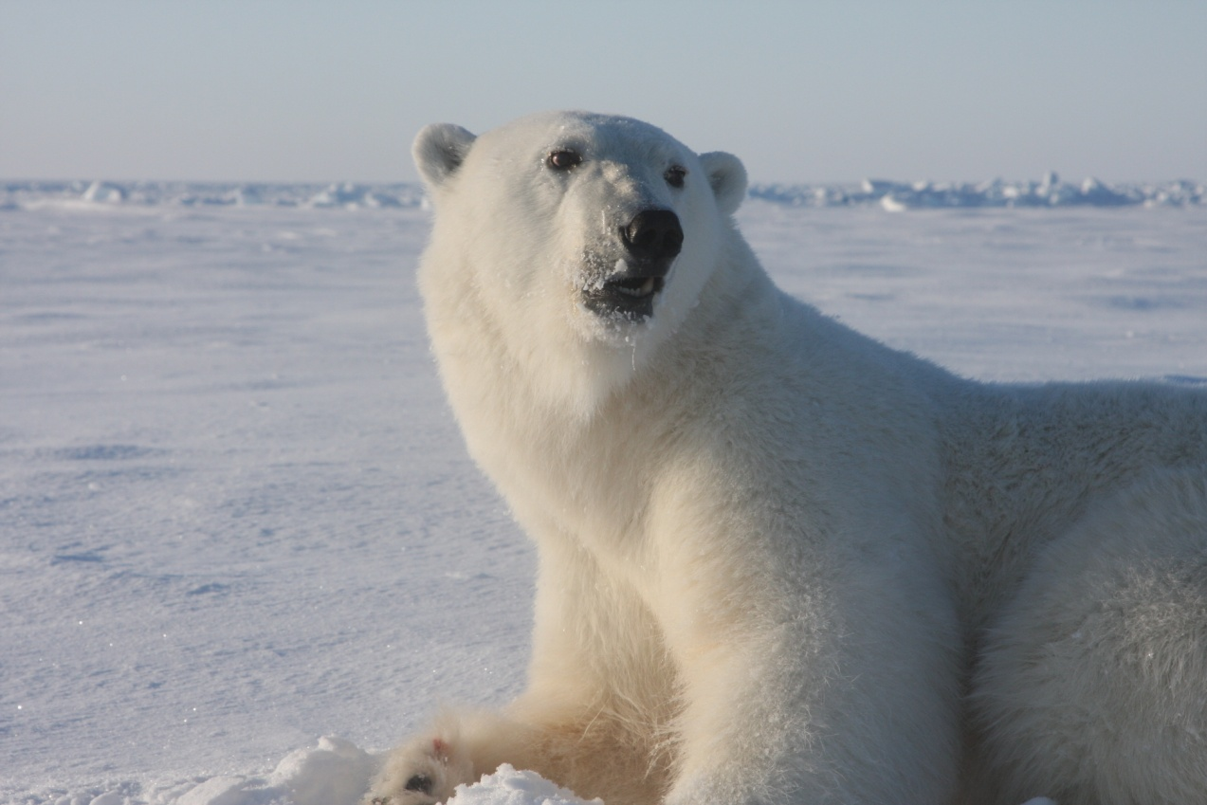
Strong preference by both sexes for high sea ice concentrations at several spatial scales.
Same strength of preference for both sexes for all habitat covariates.

Slide 23
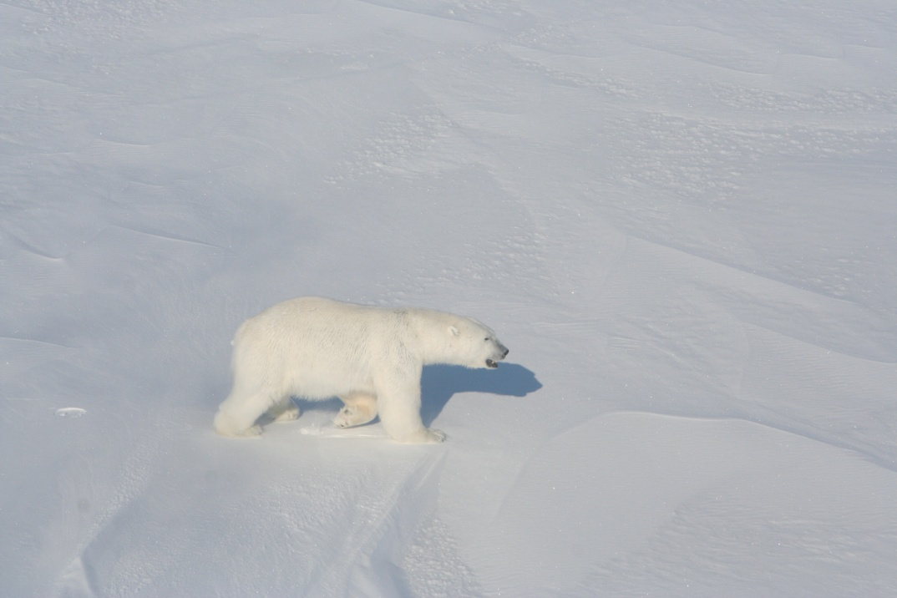
Differences related to encounter rates?
Females –Linear movement maximizes probability of encountering sparsely distributed, low-probability prey (i.e., seals)
Males – “Semi -territorial” movement leads to sufficient probability of encounter with mobile females while minimizing probability of male-male competition
K L Laidre
Laidre et al. 2012. Proceedings of the Royal Academy B.
Notes:
Why do we care about movements at all?

Slide 24
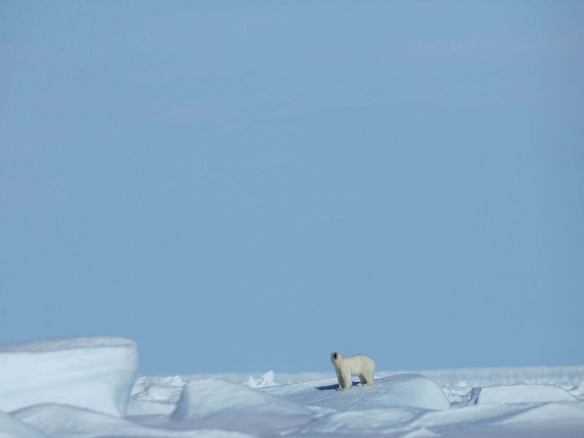
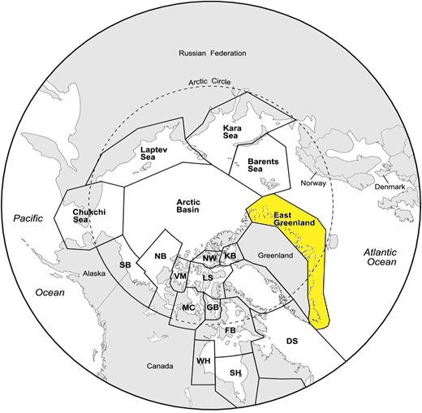
2. Resource selection in East Greenland
No assessment of this population has even been conducted.
Telemetry data in NE Greenland from 1990s and 2007-08.
Quantify resource use and possible changes over decades.
BB
Laidre et al. In review. Polar Biology

Slide 25

With assistance from Hyperwall team, AMSR-E

Slide 26
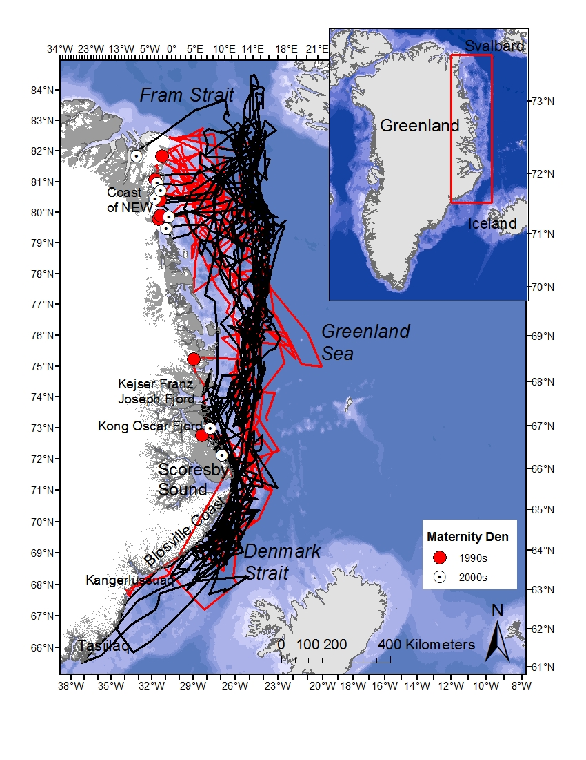
AMSR-E and SSMI sea ice habitat covariates
Habitat selection, maternity denning timing and site selection
Only adult females with collars
Contrast 1990s with 2000s

Slide 27
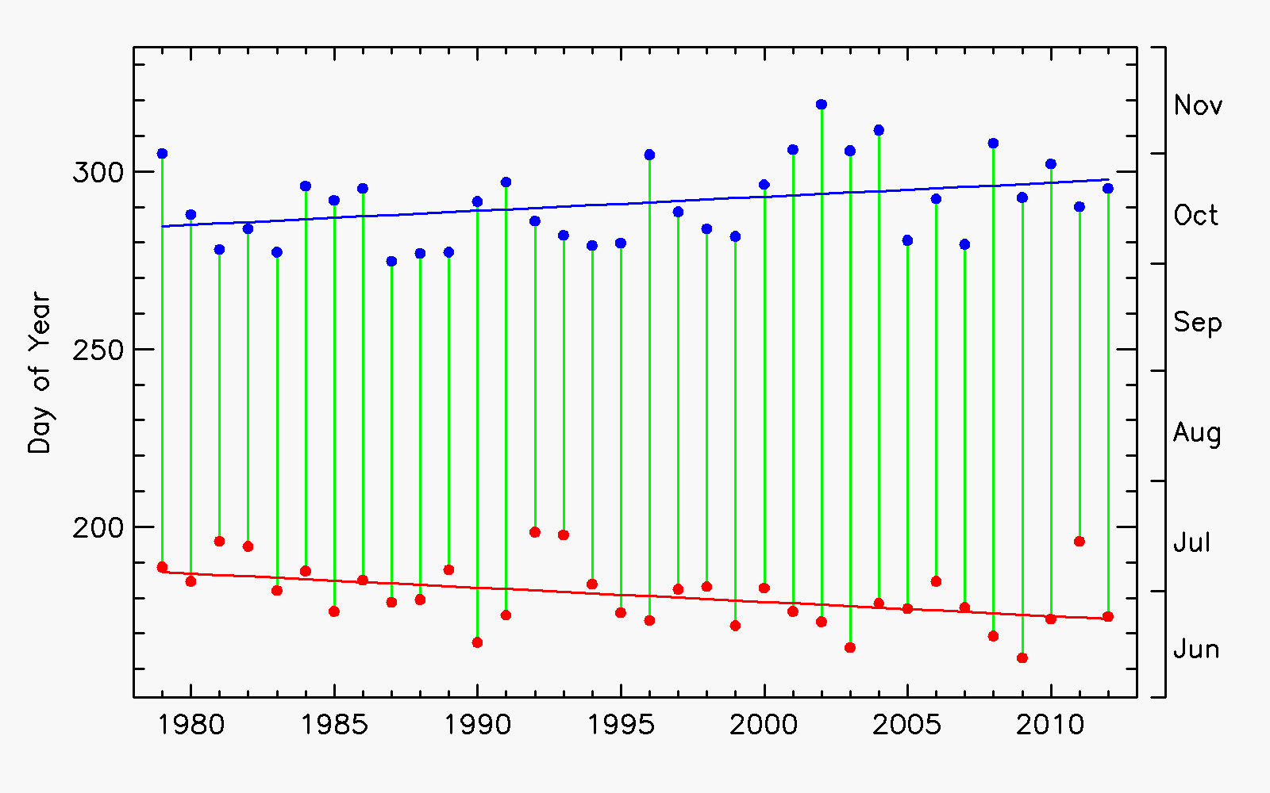
Availability of sea ice in East Greenland, 1979 - 2013
Fall freeze up
Duration of ice free season
Spring break up
SSM/I

Slide 28
In 2000s, adult females located significantly closer (100-150 km) to open water in all seasons than in 1990s.
In 2000s, adult females used areas with <60% sea ice concentration two months longer than females in the 1990s.

Slide 29
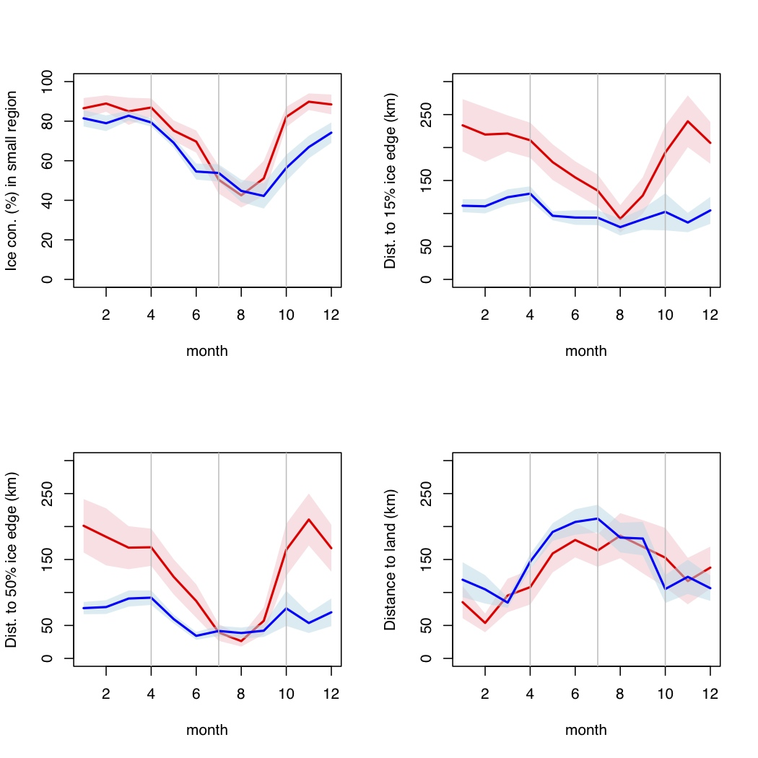
1990s, 2000s
SSM/I
Laidre et al. In review. Polar Biology

Slide 30
3. Circumpolar trends in sea ice habitat loss
Timing of sea ice formation and recession is critical.
Calculated dates of spring sea ice retreat and fall sea ice advance using SSM/I satellite data (1979-2013).
Encompasses change in the seasonal open-water period.
Partial support: NASA Climate Indicators Program

Slide 31
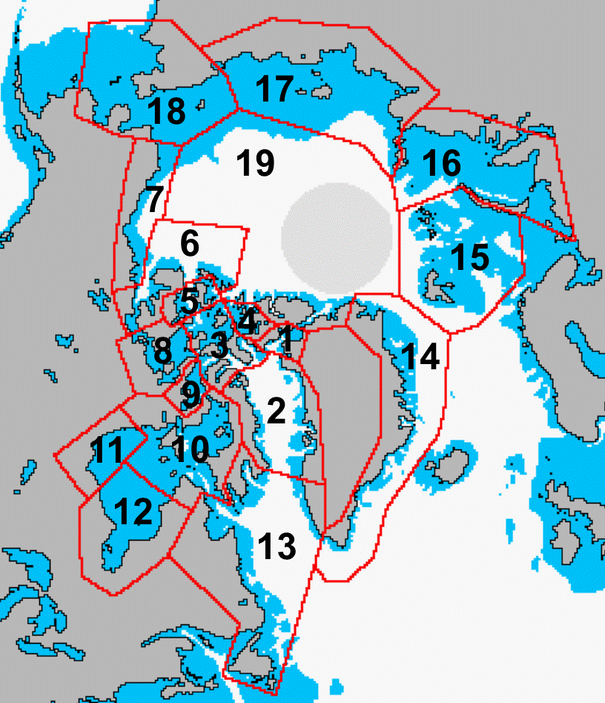
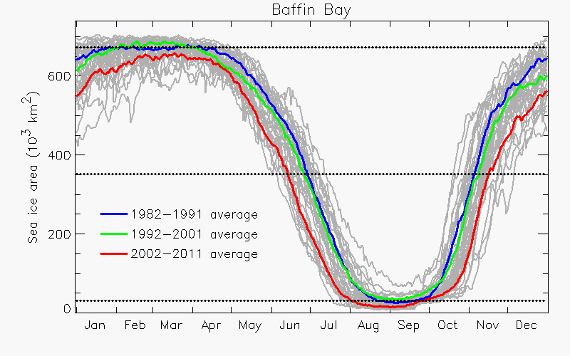
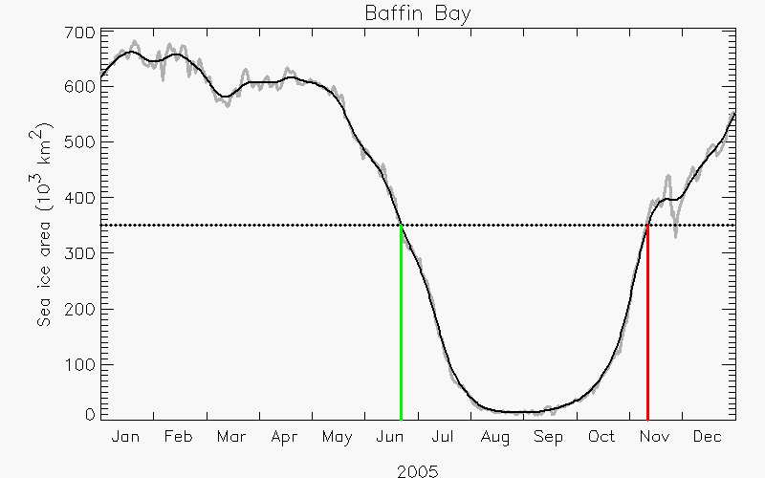
Timing of Sea-Ice Advance and Retreat
Data: Gridded daily sea-ice concentration (nominal cell size 25 x 25 km) from the National Snow and Ice Data Center, Boulder
1
19 polar bear sub-populations
2
Calculate the daily sea-ice area in each region, 1979-present
3
For each year, find the day in spring when sea-ice area drops below a threshold,
and the day in fall when sea-ice area rises above the threshold
Test threshold sensitivity.

Slide 32
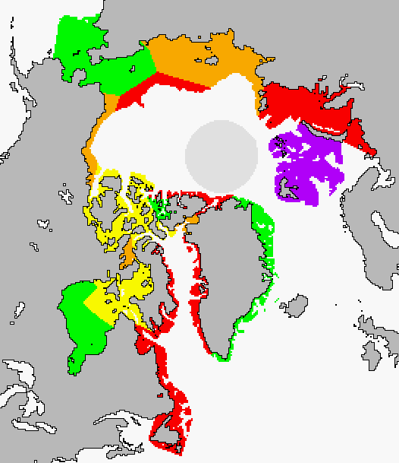
Subpopulation specific trends
Russia
19 PBSG Regions
Trend Map
Alaska
depth < 300 m
depth > 300 m
Canada
Green-land
Trend toward longer summer season (days/decade)
Table of Trends
 |  | Spring | Fall | Interval | Corr.
1 | Kane Basin | −9.1 ± 3.2 ** | +5.7 ± 2.1 ** | +14.9 ± 4.1 ** | −0.19
2 | Baffin Bay | −8.8 ± 1.4 ** | +11.0 ± 2.9 ** | +19.8 ± 3.8 ** | −0.53 **
3 | Lancaster Sound | −7.7 ± 2.1 ** | +5.6 ± 1.2 ** | +13.4 ± 2.6 ** | −0.18
4 | Norwegian Bay | −2.6 ± 1.3 * | +5.9 ± 2.2 ** | +8.5 ± 2.8 ** | −0.20
5 | Viscount Melville | −6.5 ± 2.3 ** | +6.6 ± 4.4 | +13.1 ± 4.8 ** | +0.05
6 | Northern Beaufort | −7.3 ± 3.1 * | +3.2 ± 1.2 ** | +10.5 ± 4.0 ** | −0.64 **
7 | Southern Beaufort | −8.0 ± 2.3 ** | +8.3 ± 1.8 ** | +16.3 ± 3.7 ** | −0.56 **
8 | M’Clintock Channel | −4.0 ± 1.7 * | +6.3 ± 1.5 ** | +10.3 ± 3.0 ** | −0.74 **
9 | Gulf of Boothia | −7.0 ± 1.9 ** | +9.0 ± 1.7 ** | +16.0 ± 3.3 ** | −0.68 **
10 | Foxe Basin | −5.9 ± 1.1 ** | +6.7 ± 1.2 ** | +12.6 ± 2.0 ** | −0.53 **
11 | Western Hudson Bay | −5.4 ± 1.7 ** | +4.2 ± 1.3 ** | +9.6 ± 2.3 ** | −0.24
12 | Southern Hudson Bay | −3.1 ± 1.6 | +4.5 ± 1.5 ** | +7.6 ± 2.6 ** | −0.38 *
13 | Davis Strait | −8.1 ± 2.4 ** | +9.7 ± 1.8 ** | +17.8 ± 3.2 ** | −0.16
14 | East Greenland | −4.0 ± 1.4 ** | +3.9 ± 1.9 * | +7.9 ± 2.7 ** | −0.27
15 | Barents Sea | −16.6 ± 3.4 ** | +26.1 ± 6.2 ** | +42.7 ± 8.1 ** | −0.39 *
16 | Kara Sea | −9.9 ± 1.9 ** | +9.5 ± 2.4 ** | +19.4 ± 3.7 ** | −0.48 **
17 | Laptev Sea | −7.8 ± 2.5 ** | +6.5 ± 1.3 ** | +14.3 ± 3.5 ** | −0.72 **
18 | Chukchi Sea | −3.4 ± 1.3 * | +3.7 ± 1.5 * | +7.1 ± 2.3 ** | −0.25
19 | Arctic Basin | −6.1 ± 1.5 ** | +14.7 ± 2.7 ** | +20.8 ± 3.2 ** | −0.08
Days/Decade
7-10
10-14
14-17
17-21
> 21
p < 0.05
p < 0.01

Slide 33
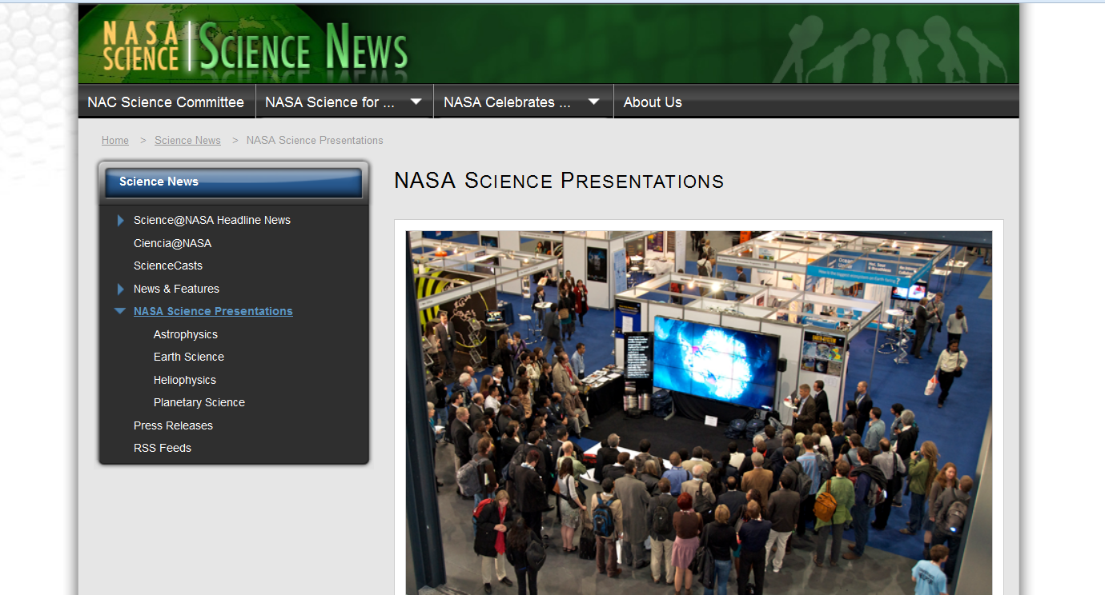
Hyperwall talk, International Congress for Conservation Biology , Baltimore, MD 2013

Slide 34
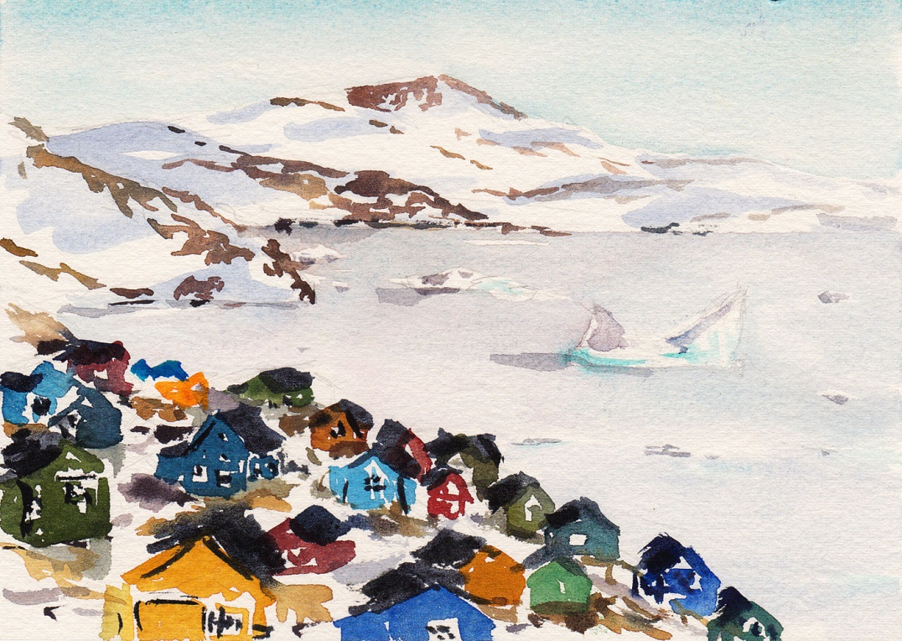
Outreach
Imagingthearctic.org

Slide 35
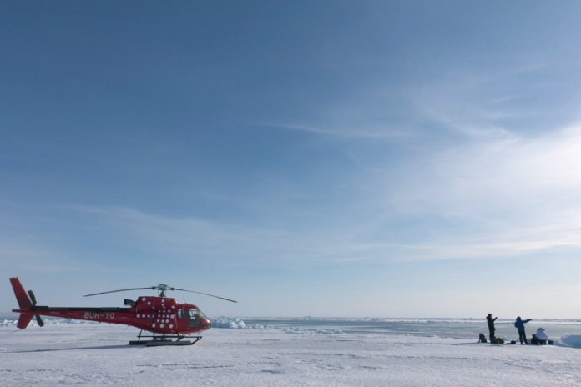
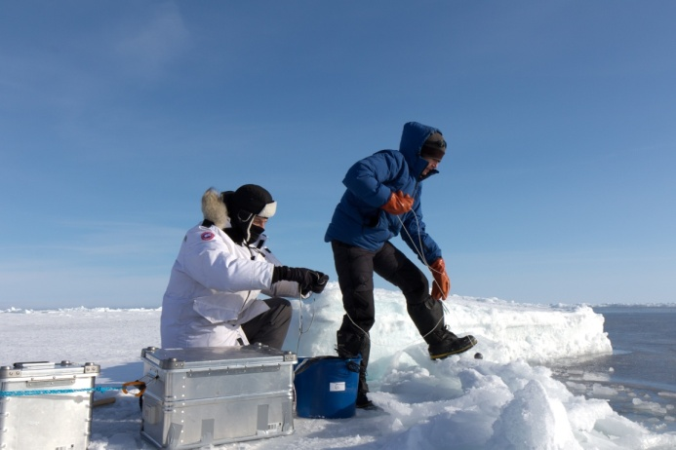
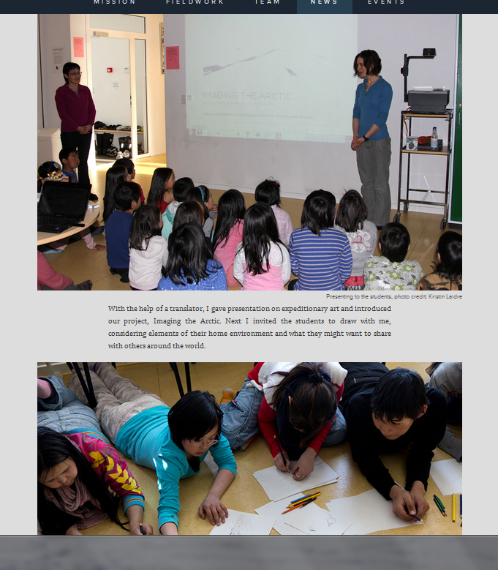
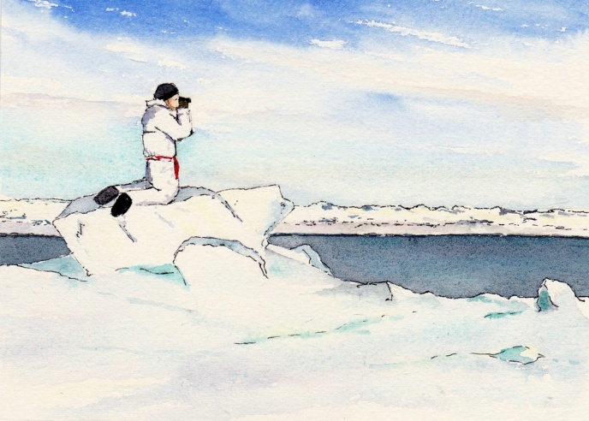
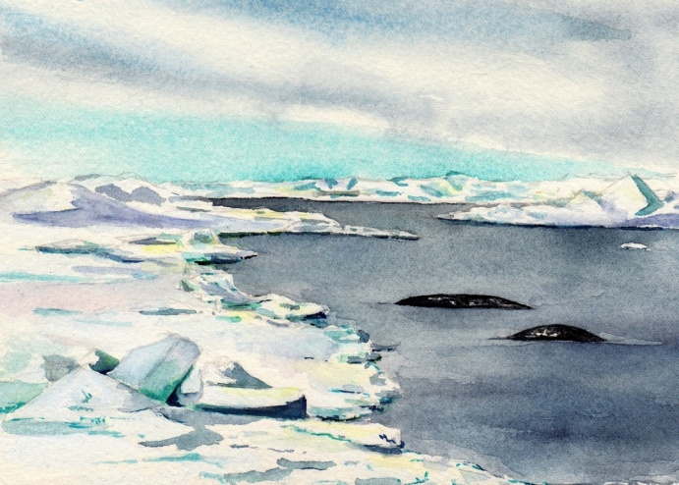
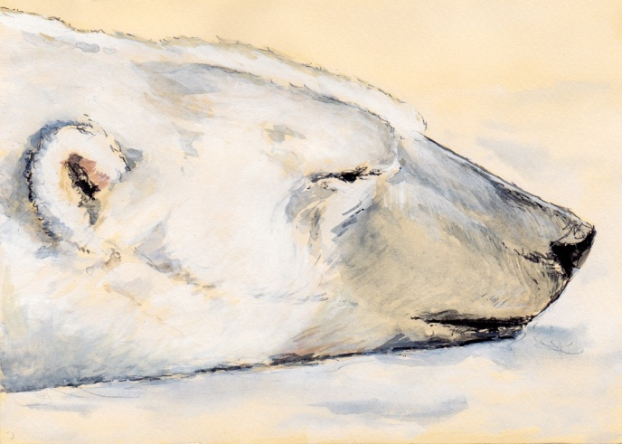
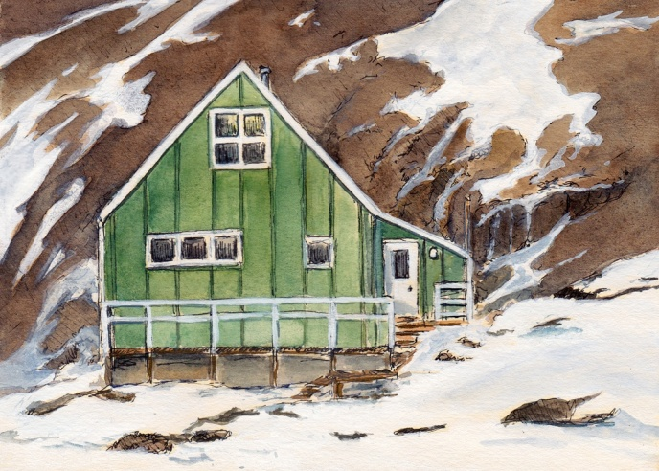
Imagingthearctic.org
Talks in Greenland schools
Kullorsuaq, Greenland, 2013

Slide 36
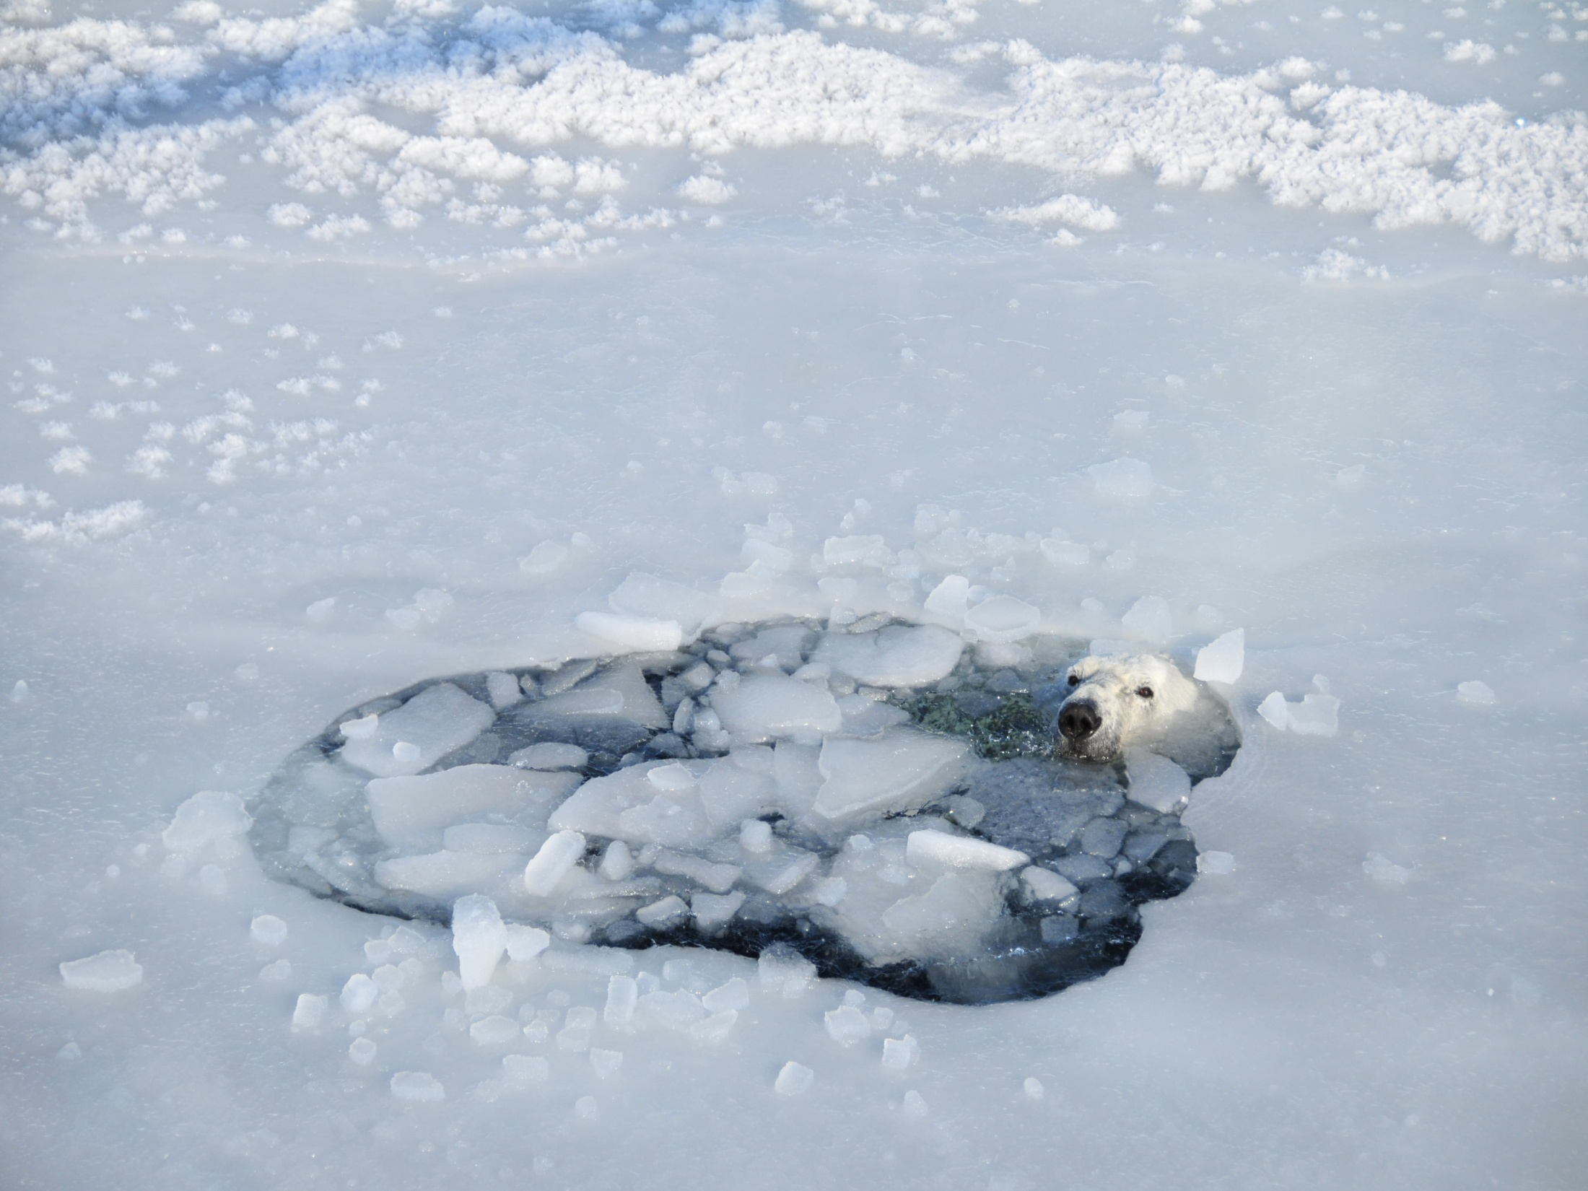
Acknowledgements
NASA Biodiversity and Ecological Forecasting
NASA Climate Indicators Program (PI H. Stern)
Greenland Institute of Natural Resources, Nuuk
Danish Ministry for the Environment
Polar Science Center (University of Washington)
Vetlesen Foundation
K Laidre

